Slide 1
Investment Casting Process
investment casting processes names

Slide 2
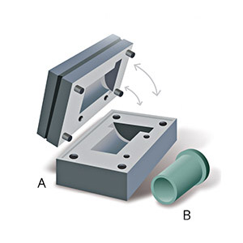
Step 1:
Tooling and Pattern Making
A tool is built to customer-provided specifications (A). Cold wax is then injected into the tool to create a wax pattern/prototype (B). That will hold precise dimensional requirements in final casting.

Slide 3
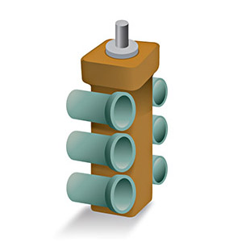
Step 2:
Pattern Assembly
The wax patterns are assembled onto the sprue.

Slide 4
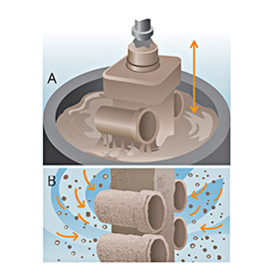
Step 3:
Dipping and Coating
Successive layers of ceramic (A) and are applied to the sprue assembly to form a hard shell.

Slide 5
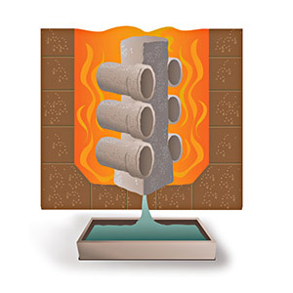
Step 4:
De-Waxing and Firing
The molds are flash-fired to remove the wax and sprue materials and then heated to 1,800º and placed on a send bed, ready for pouring.

Slide 6
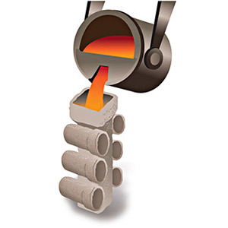
Step 5
Casting
Molten metal, up to 3,000º, is poured into the hollow mold and then cooled.

Slide 7
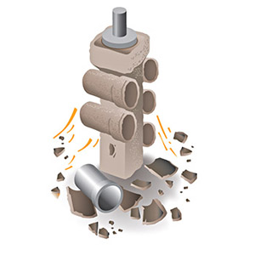
Step 6:
Knockout
The ceramic shell is broken off, and the individual castings are cut away.

Slide 8
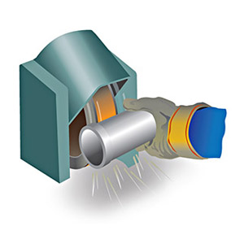
Step 7:
Finishing
Excess metal is removed, surfaces are finished, and castings are heat treated.

Slide 9
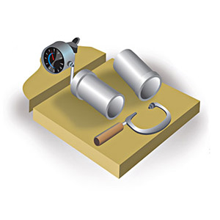
Step 8:
Testing and Inspection
Casting undergo thorough testing and inspection to ensure that they meet dimensional tolerances and specifications.

Slide 10
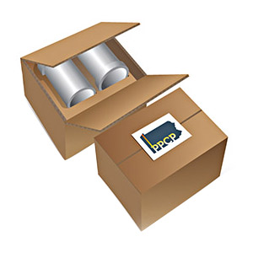
Step 9:
Packing and Shipping
Castings are securely packaged for shipping to the customer.

